Slide 1
Information Systems and Competitive advantage

Slide 2
Information Systems in Organization

Slide 3
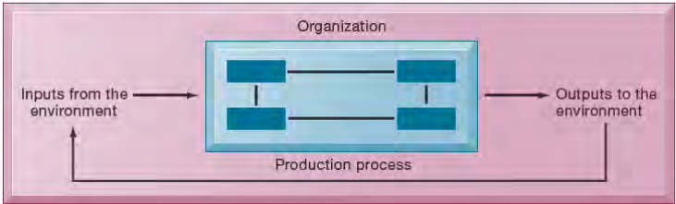
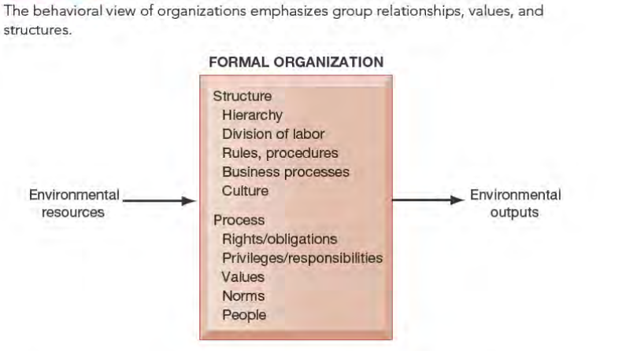
Organization

Slide 4
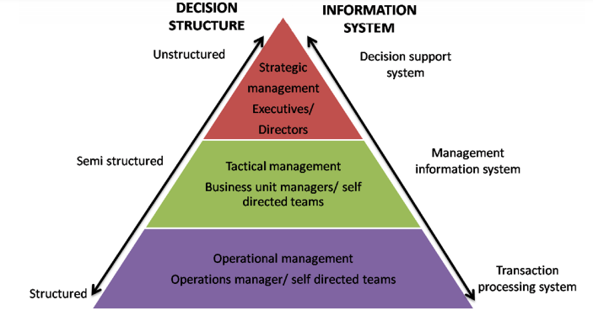
Decision-Making Levels of an Organization

Slide 5
Executive level
Focus on long-term strategic questions
Which products to produce, which countries to compete in, what organizational strategy for follow.
Decision: unstructured decisions
Complex and non-routine.
Few or no Procedures can be specified in advance
Notes:
e.g. decide to develop or discontinue a product
→ IS are used to obtain aggregate summaries of trends and projection of the future

Slide 6
Managerial level
Functional managers (e.g. marketing, finance, manufacturing managers) focus on:
monitoring operational-level activities and providing info to higher levels.
Utilizing organizational resources to increase Effectiveness (goals/tasks to accomplished well)
Decision: semi-structured decisions
Solutions/problems are not clear-cut, require judgment.
Procedures can be specified in advance, but not to the extent where a specific recommendation can be made
Notes:
Ex:IS provide production mânger with performance analytics and forecast about sales for multi production lines, inventory level and overall production capacity → create production schedules → perform predictive analyses to examine inventory levels and potential sales profitability.

Slide 7
Operational level
Routine, day-to-day business process
Decision: structured decisions
Procedures are specified in advance
Can be programed
IS: are used to increase Efficiency (faster, lower cost)
Notes:
IS are designed to automate repetitive activities (eg. Sales transaction)

Slide 8
Systems For Different Levels of Management
Transaction processing systems:
Keep track of basic activities and transactions of organization (e.g., sales, receipts, cash deposits, payroll, credit decisions, flow of materials in a factory).
Management information systems and decision-support systems:
Help with monitoring, controlling, decision making, and administrative activities.
Executive support systems:
Help address strategic issues and long-term trends, both in firm and in external environment.
Notes:
The constituency perspective emphasizes which groups in the firm are served by specific systems.

Slide 9
Transaction Processing Systems (TPS)
Operational level
Purpose:
Processing of business events and transactions
Increase efficiency
Automation
Lower costs
Increased speed and accuracy
Examples:
Payroll processing
Sales and order processing
Inventory management
Product purchasing, receiving, and shipping
Accounts payable and receivable

Slide 10
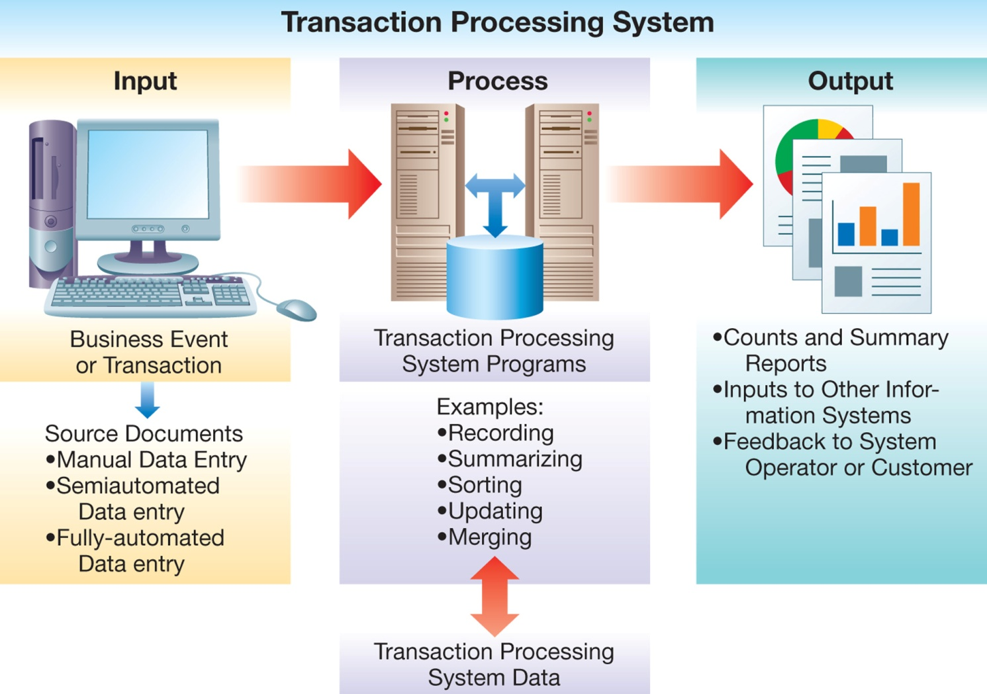
Architecture of a TPS

Slide 11
Architecture of a TPS: Inputs
Source documents
Different data entry methods

Slide 12
Architecture of a TPS: Processing
Online processing
Immediate results
Batch processing
Transactions collected and later processed together
Used when immediate notification not necessary

Slide 13
Architecture of a TPS: Outputs
Counts, summary reports
Inputs to other systems
Feedback to systems operator

Slide 14
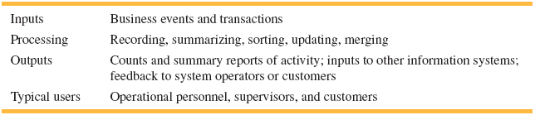
Summary of TPS Characteristics
Source: Textbook [2]

Slide 15
Management Information Systems
Managerial level
Purpose:
Produce reports
Support of midlevel managers’ decisions
Examples:
Sales forecasting
Financial management and forecasting
Manufacturing, planning and scheduling
Inventory management and planning
Advertising and product pricing

Slide 16
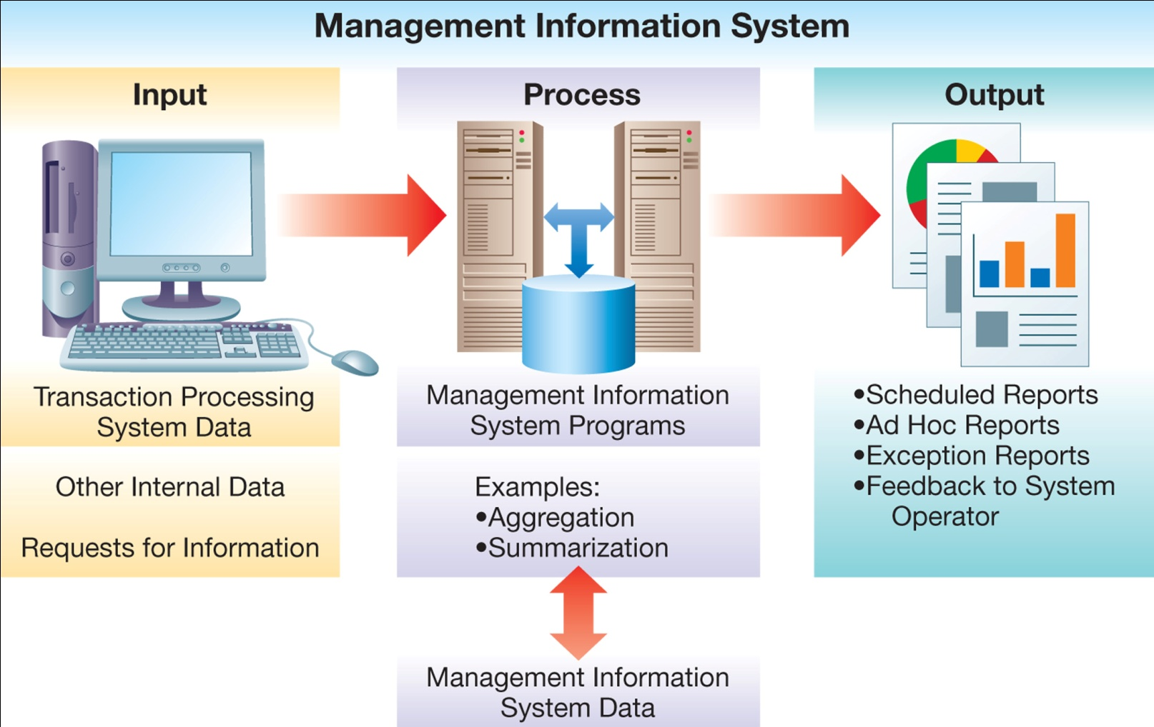
Architecture of an MIS

Slide 17
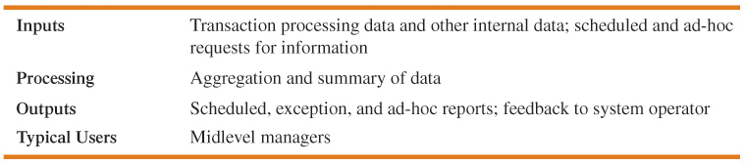
Summary of MIS Characteristics

Slide 18
Decision Support Systems (DSS)
Decision-making support for recurring problems
Used mostly by managerial level employees
Interactive decision aid
What-if analyses
Analyze results for hypothetical changes
Example: Microsoft Excel

Slide 19
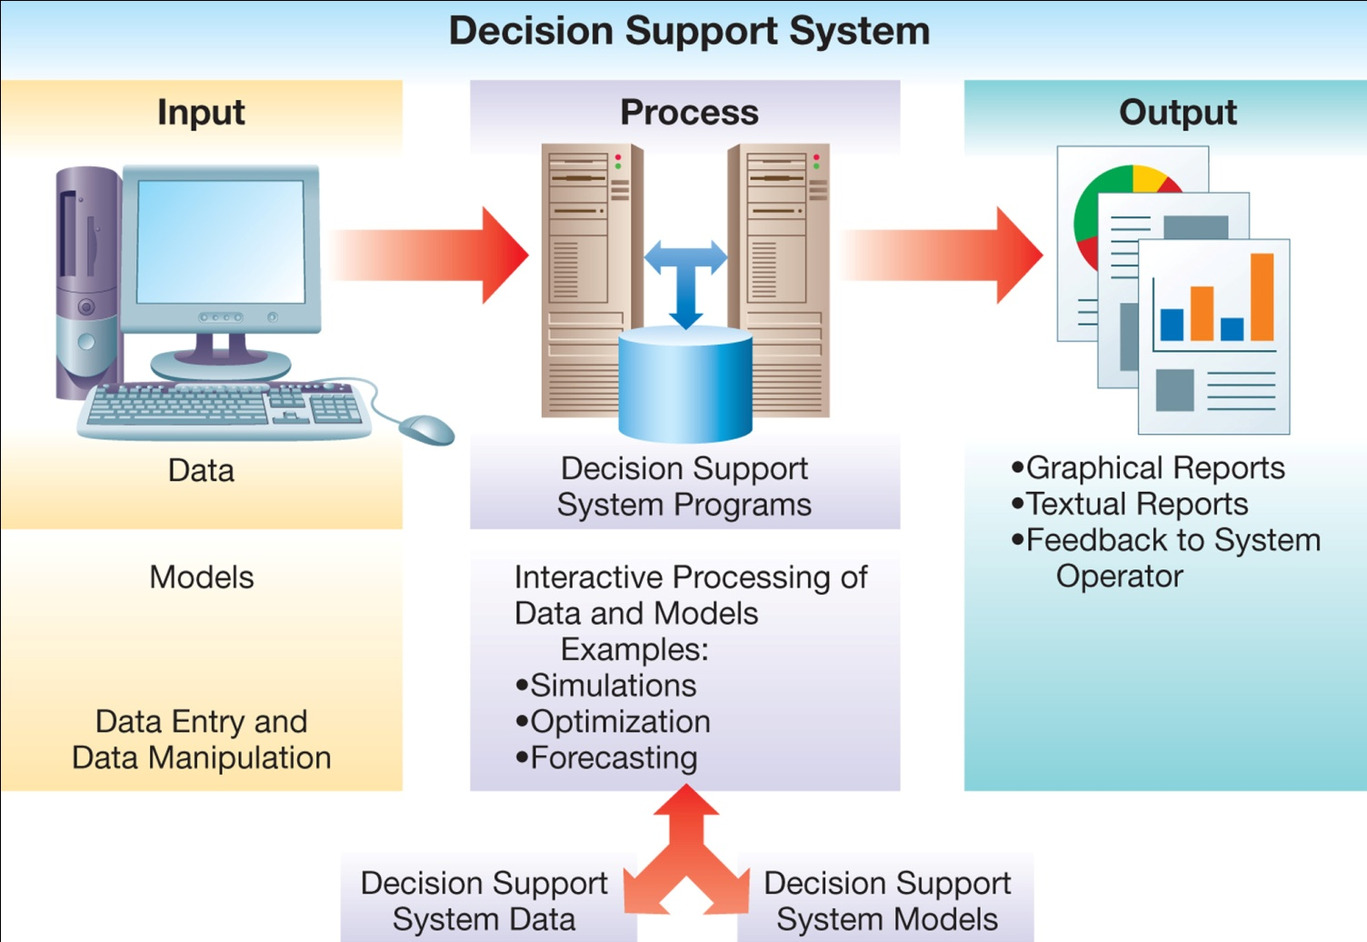
Architecture of a DSS

Slide 20
Executive Support System (ESS)
Aka Executive Information system (EIS)
Executive level
Purpose:
Aid in executive decision making
Provide information in highly aggregated form
Examples:
Executive-level decision making
Long-range and strategic planning
Monitoring of internal and external events and resources
Crisis management
Staffing and labor relations

Slide 21
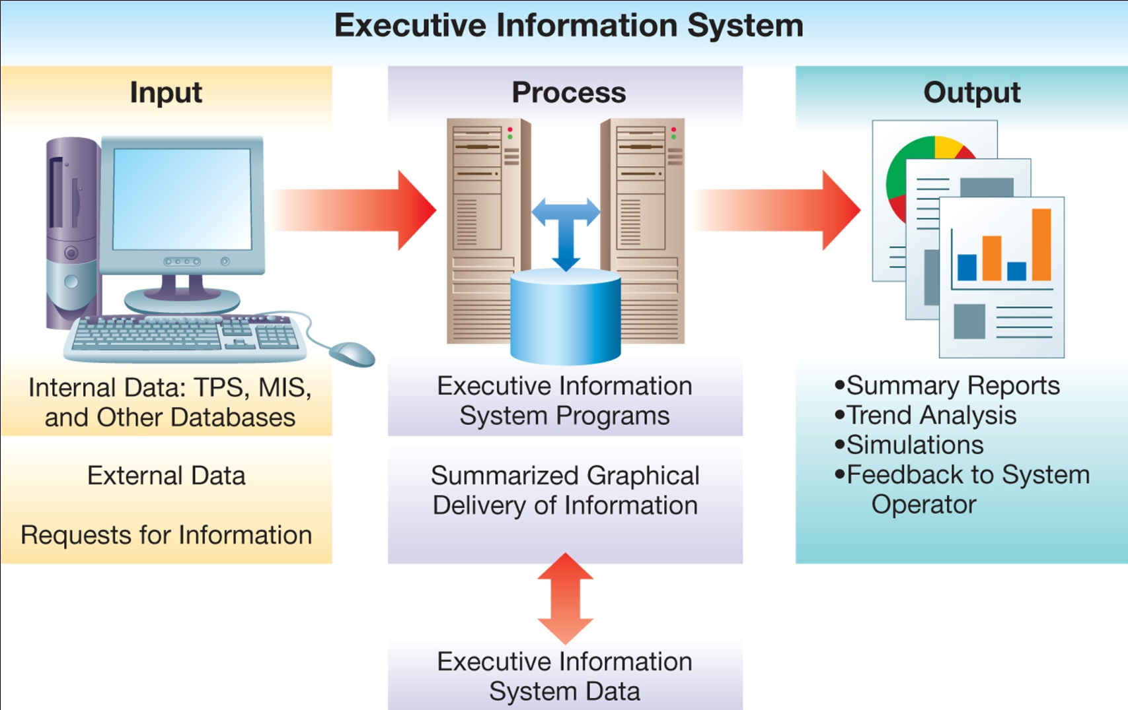
Architecture of an ESS

Slide 22
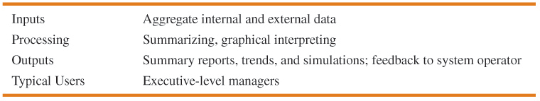
Summary of ESS Characteristics

Slide 23
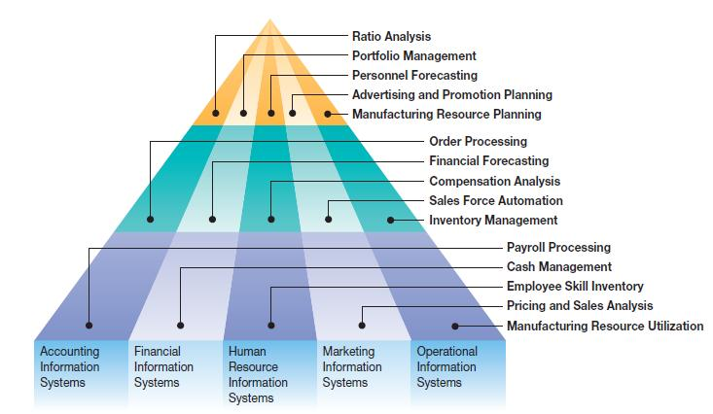
Business Process Supported by Functional Area IS

Slide 24
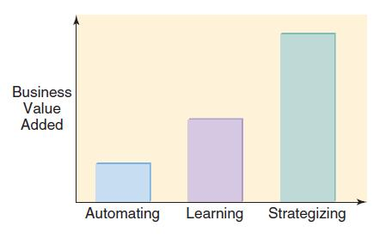
Major IS Tasks: Business Value Added
Automating: Doing Things Faster
Organizational Learning: Doing Things Better
Supporting Strategy: Doing Things Smarter

Slide 25
Strategy

Slide 26
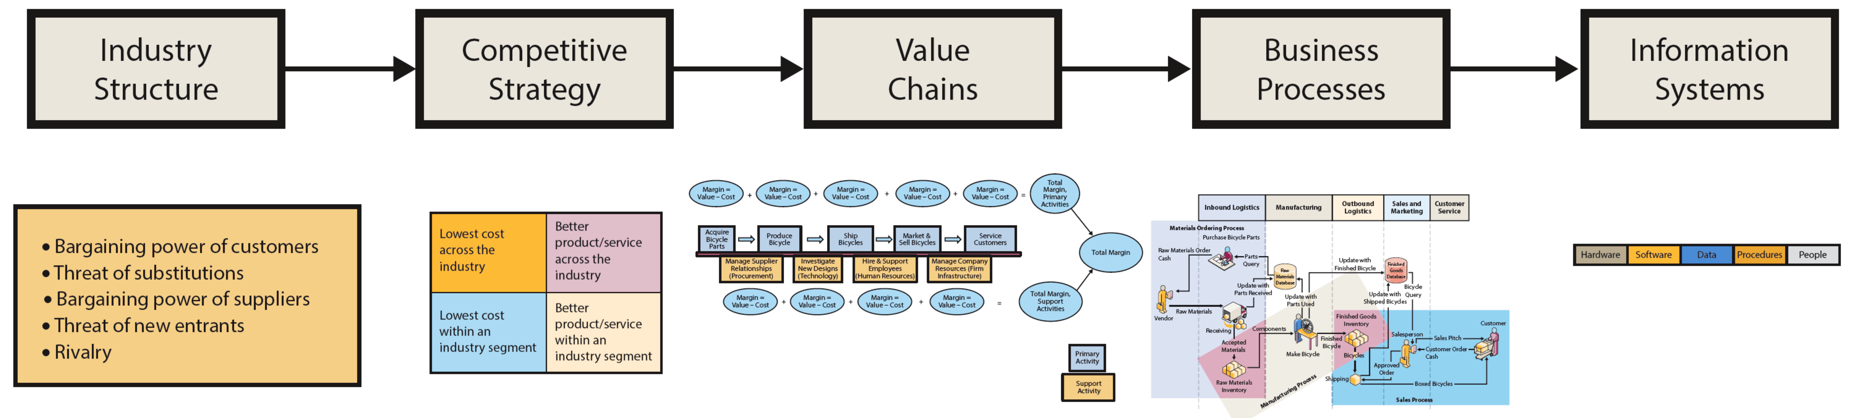
How Does Organizational Strategy Determine Information Systems Structure?
Source: textbook [1], pg 68
Notes:
Figure 3-1 summarizes a planning process used by many organizations.
Start with Porter's Five Forces to analyze industry structure.
Information systems exist to help organizations achieve their goals and objectives
an organization’s goals and objectives are determined by its competitive strategy. Thus, ultimately, competitive strategy determines the structure, features, and functions of every information system.

Slide 27
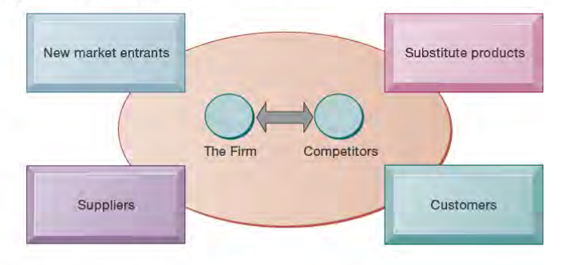
What Five Forces Determine Industry Structure?
Notes:
Competitive Forces
• Competition from vendors of substitutes.
• Competition from new competitors.
• Competition from existing rivals.
Bargaining Power Forces
• Bargaining power of suppliers.
• Bargaining power of customers.

Slide 28
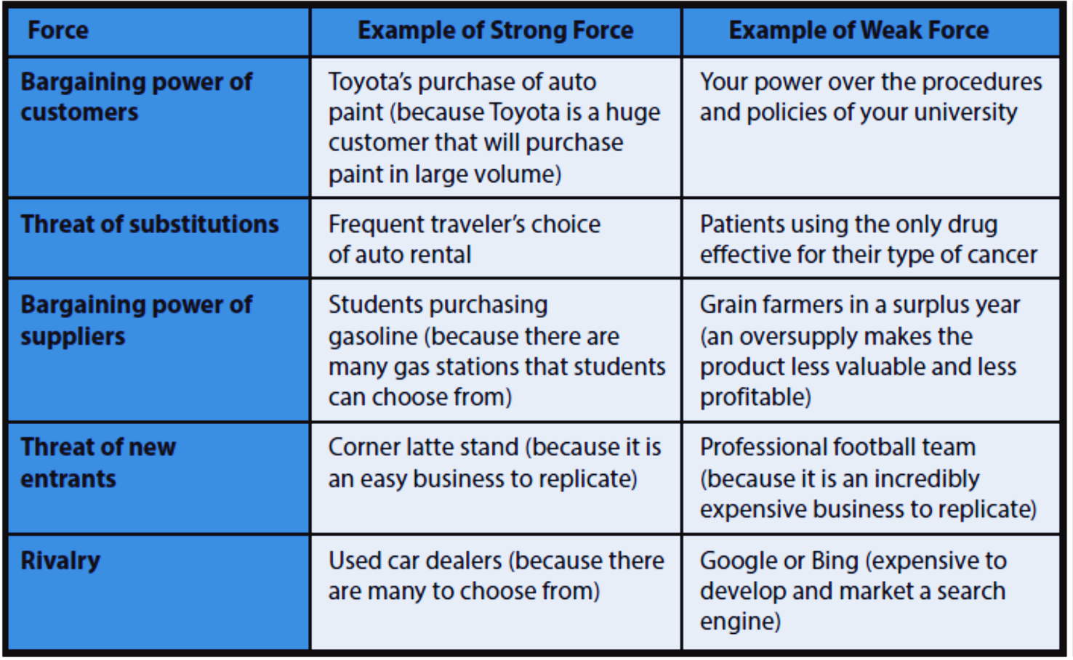
Use 5-forces Model to Identify Sources of Strong Competition
Source: textbook[1], pg 69
Notes:
The intensity of each of the five forces determines the characteristics of the industry, how profitable it is, and how sustainable that profitability will be.

Slide 29
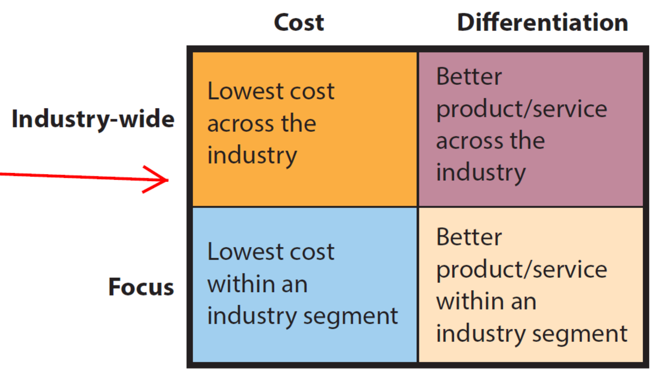
How Does Analysis of Industry Structure Determine Competitive Strategy?
Porter's Four Competitive Strategies
Source: textbook [1], pg 70
Notes:
To be effective an organization goals, objectives, culture, and activities must be consistent with the organization’s strategy.
This means, all information systems in organization must facilitate the organization’s competitive strategy.
Each of the three competitive forces concerns the danger of customers taking their business elsewhere.
Have students examine table to see why AllRoad is exploring possibility of 3D printing.

Slide 30
Business – IS alignment
To be effective goals, objectives, culture, and activities must be consistent with strategy.
In MIS, this means all information systems must reflect and facilitate the organization's competitive strategy.

Slide 31
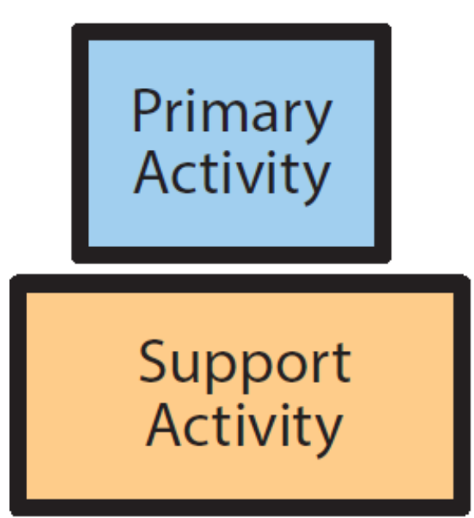
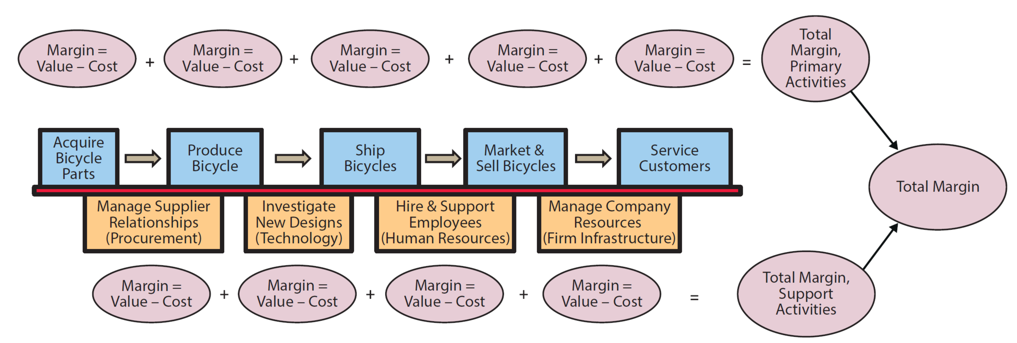
How Does Competitive Strategy Determine Value Chain Structure?
Linkages
Source: textbook [1], pg 71
Notes:
Value chain is a network of value-creating activities.
value as the amount of money that a customer is willing to pay for a resource, product, or service
Difference between value an activity generates and its cost is called margin.
Linkages--interactions across value activities.

Slide 32
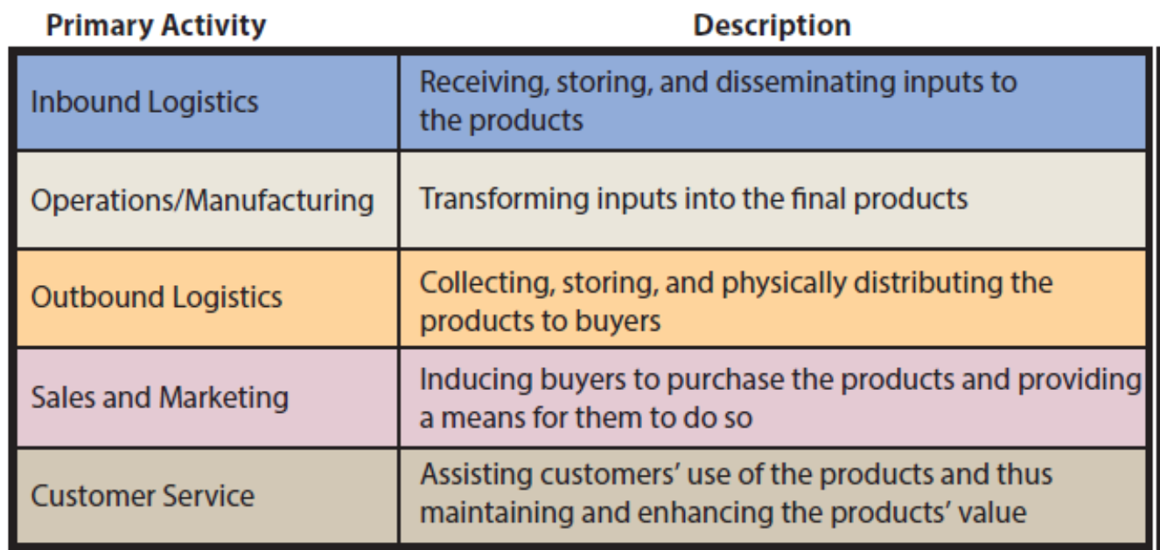
Task Descriptions for Primary Activities of the Value Chain
Source: textbook [1], pg 72
Notes:
Summarizes the primary activities of the value chain.
The support activities in the generic value chain contribute indirectly to the production, sale, and service of the product.

Slide 33
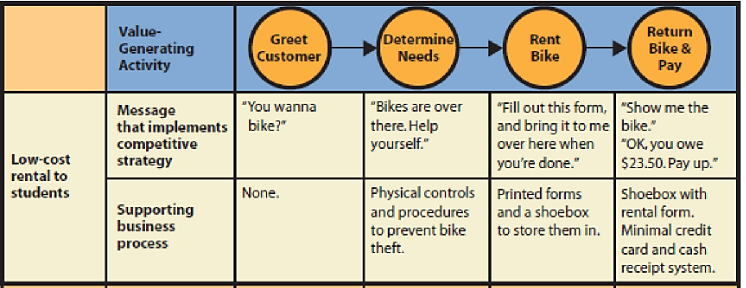
How Does Competitive Strategy Determine Business Processes and the Structure of IS?
Low-Cost Rental Value Chain
Source: textbook [1], pg 78

Slide 34
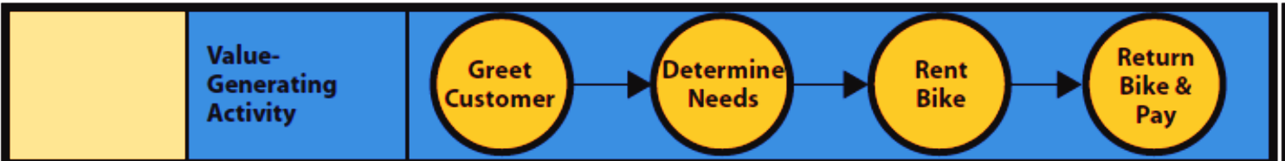
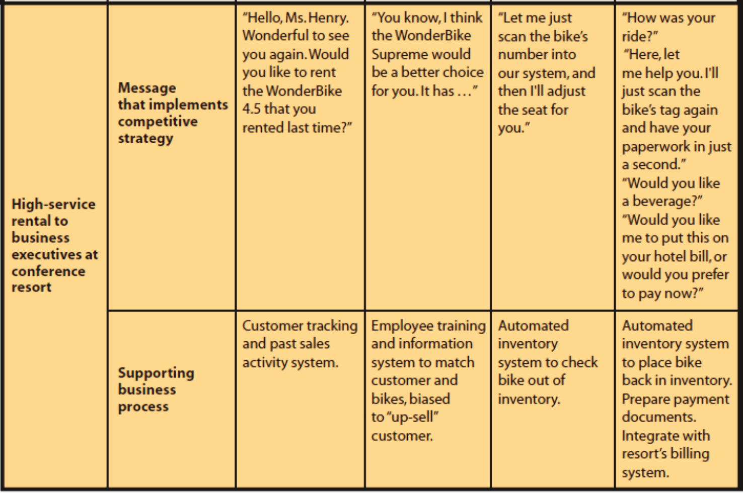
High-Service Rental Value Chain
Source: textbook [1], pg 78

Slide 35
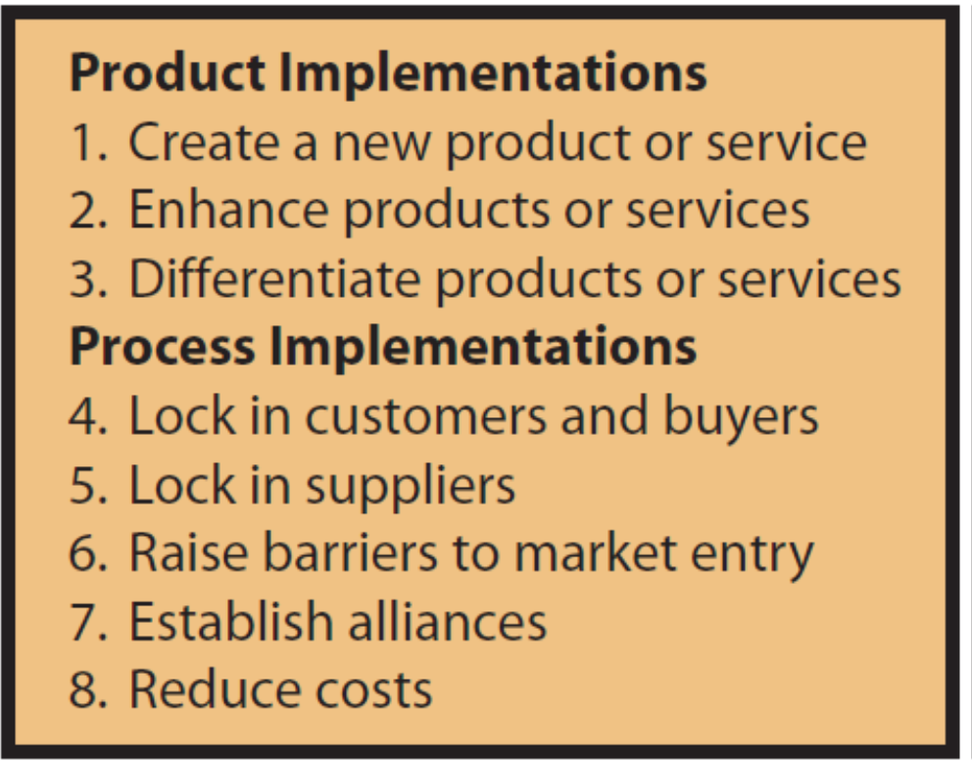
How Do IS Provide Competitive Advantages?
Principles of Competitive
Advantage
Source: textbook [1], pg 79
Notes:
Car rental agency like Hertz or Avis. An information system produces information about car’s location and provides driving instructions to destinations part of the product.
Information system that schedules car maintenance supports the product.
lock in customers by making it difficult or expensive for customers to switch to another product
lock in suppliers by making it difficult to switch to another organization, or, stated positively, by making it easy to connect to and work with the organization.

Slide 36
Q&A

